Slide 1
iMoMo Irrigation Demand Calculator and Water Stress Monitor
Sebastian Stoll, hydrosolutions ltd.
26.03.2014
Bishkek

Slide 2
Irrigation Demand Calculator

Slide 3
Motivation
Irrigation water allocation needs planning:
Basin authorities need information for future planning and management
Water user associations need usable information for planning and negotiation
Who gets how much water?
Climate
Soil
Crop
Planting Date
Irrigation type

Slide 4
Irrigation Calculator
‘Tool to calculate the irrigation water demand of a specific crop, on a specific soil under a specific climate’
Based on FAO56 methodology (‘Crop evapotranspiration - Guidelines for computing crop water requirements - FAO Irrigation and drainage paper 56’)
Required inputs:
climatic data
crop parameters
soil parameters
planting dates

Slide 5
Soil water balance model
D_{r, i} = Root zone depletion (mm) at the end of day i
P_{i} = Precipitation (mm) on day i
R_{i} = Runoff(mm) on day i
I_{i} = Irrigation(mm) on day i
CR_{i} = Capillary rise (mm) on day i
ET_{c,i} = Crop evapotranspiration (mm) on day i
DP_{i} = Deep percolation (mm) on day i

Slide 6
Parameters
Longterm climate data (P, Tmean,Tmax,Tmin)
Station data
Satellite data
Reanalysis data
Crop parameters (Kc, growing period, root depth, depletion f.)
Literature
Expert knowledge
Soil parameters (field capacity, wilting point)
Soil maps
Expert knowledge

Slide 7
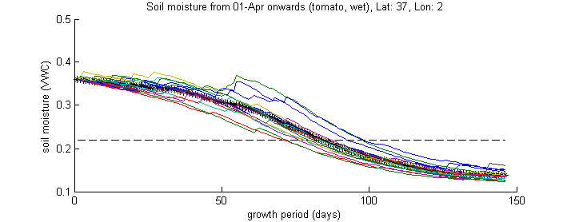
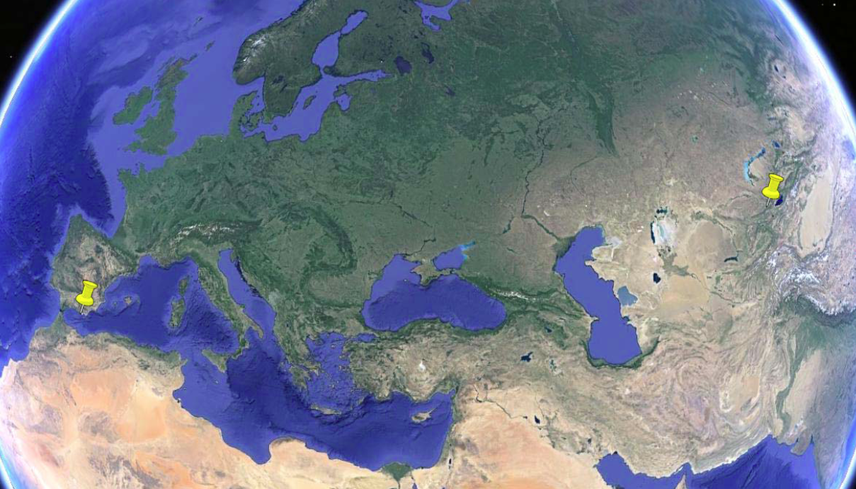
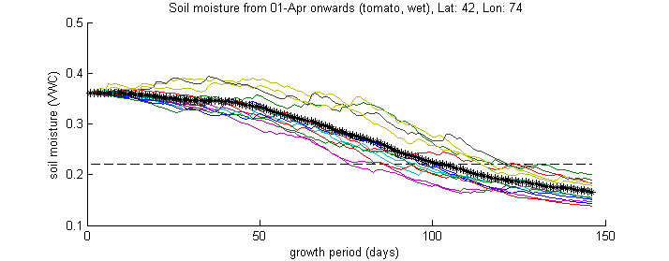
Comparison: climate
Almeria (Spain):
159 mm/m²
Bishkek
Almeria
Bishkek:
104 mm/m²
(©GoogleEarth)

Slide 8
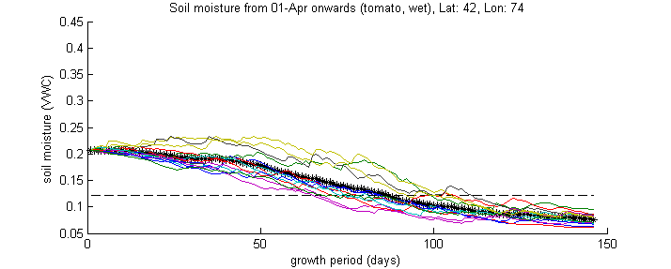
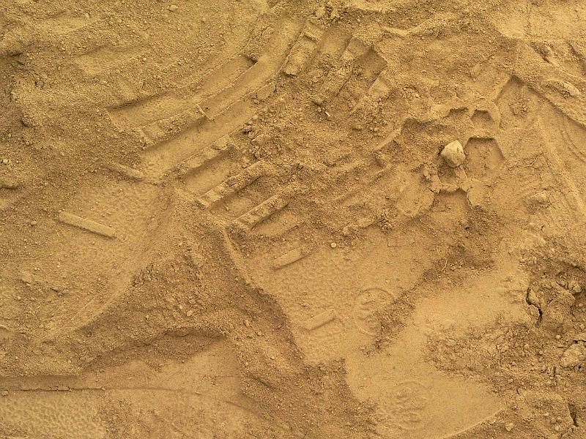
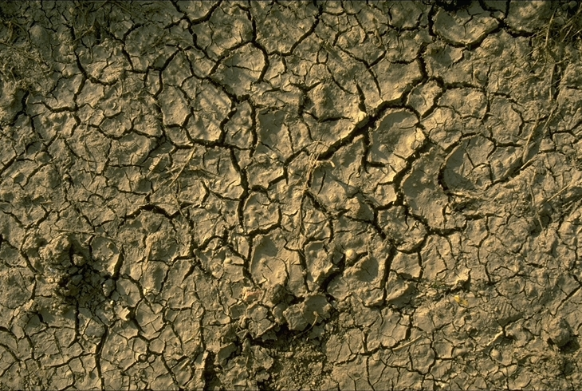
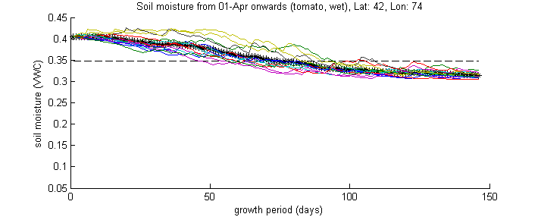
Comparison: soil
Sandy soil
Clayey soil
Sandy soil:
76 mm/m²
Clayey soil:
62 mm/m²
(www.soil-net.com)
(www.planat.ch)

Slide 9
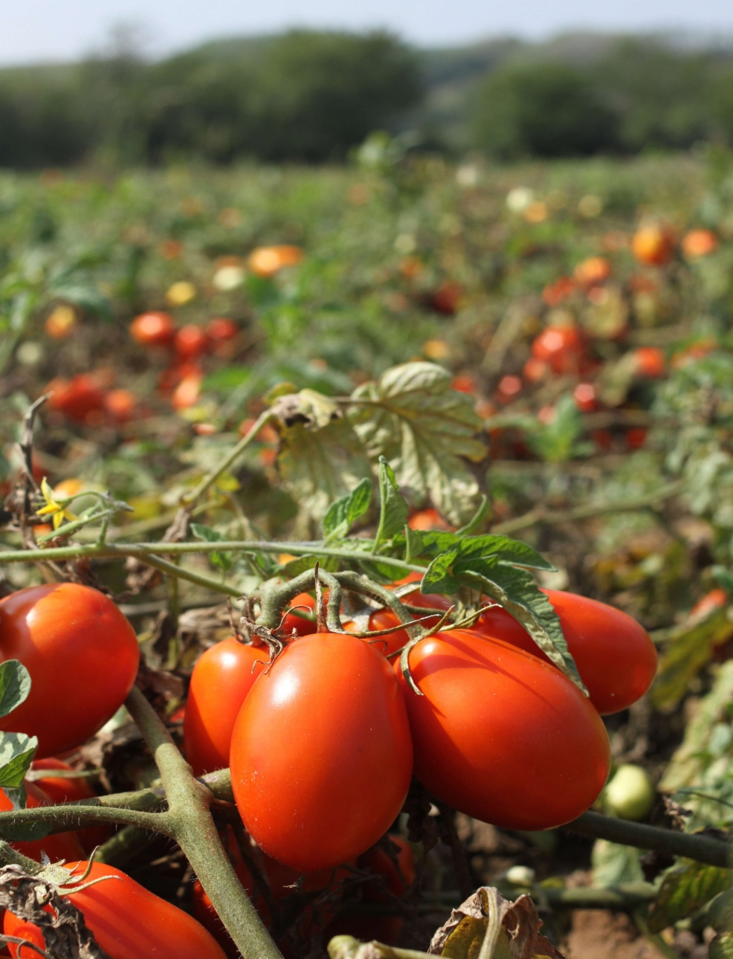
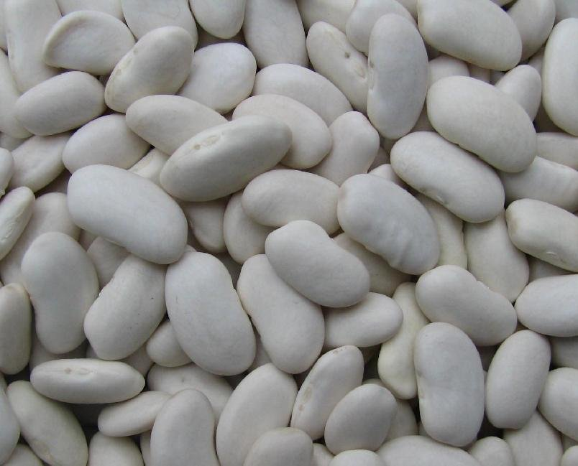
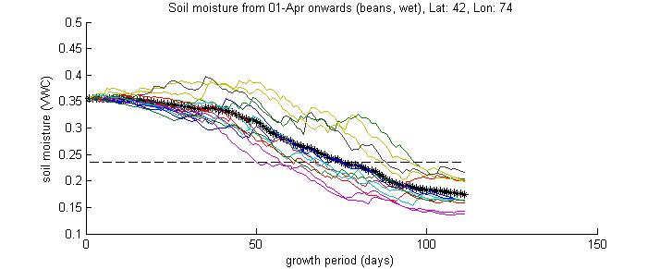
Comparison: crop
Tomato
Beans
Tomato :
104 mm/m²
Beans:
53 mm/m²
(www.jovialfoods.com)
(www.21food.com)

Slide 10
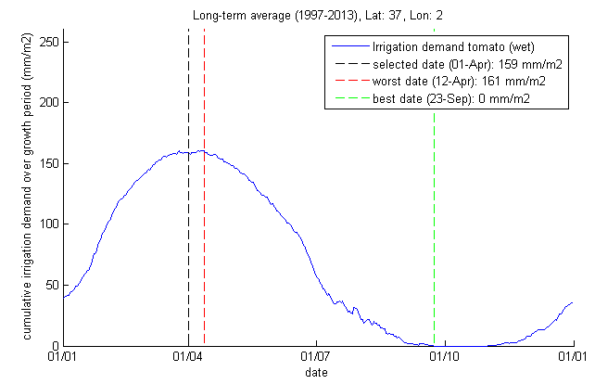
Comparison: planting date

Slide 11
Benefits
Optimal water allocation planning
Minimization of unproductive losses due to inequitable water allocation
Evaluation of maximum cultivated area under the given irrigation water availability
Evaluation of optimal crop choice and planting dates

Slide 12
Water Stress Monitor

Slide 13
Motivation
Irrigation water allocation/application needs monitoring:
Basin authorities need information for real-time management
Water user associations need usable information for negotiations and real-time allocation
Farmers need information for efficient irrigation water application (when and where to irrigate)

Slide 14
Water Stress Monitor
‘Tool to monitor current soil moisture conditions and water demands via crowd sensing’
FAO56 methodology (‘Crop evapotranspiration - Guidelines for computing crop water requirements - FAO Irrigation and drainage paper 56’)
Qualitative field observations of shallow soil moisture (Rinderer M., Kollegger A., Fischer B. M. C., Stähli M., Seibert J. (2012): Sensing with boots and trousers-qualitative field observations of shallow soil moisture patterns, Hydrological Processes, doi: 10.1002/hyp.9531).
modeling
soft data

Slide 15
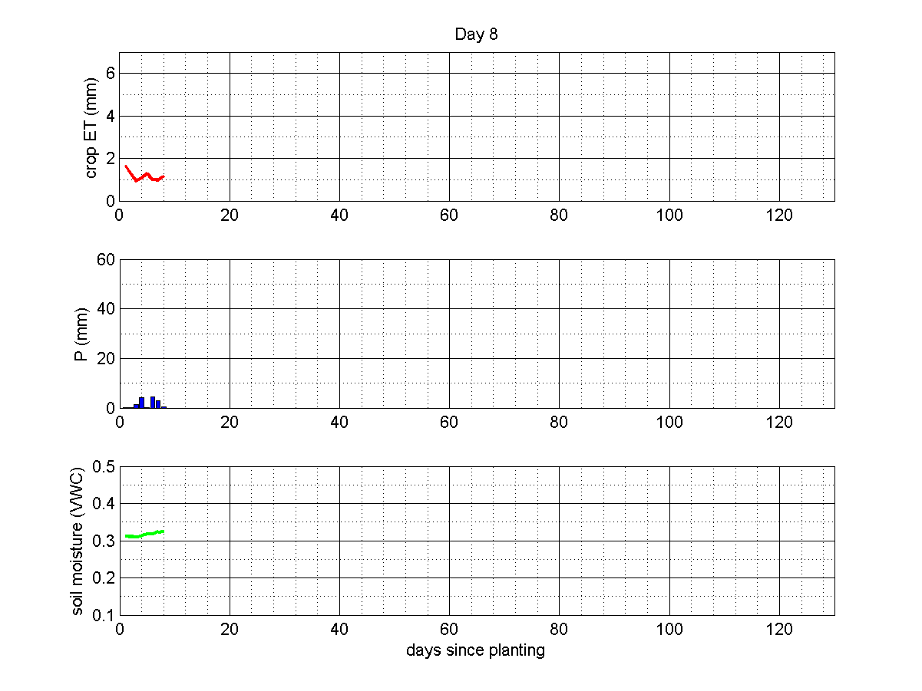
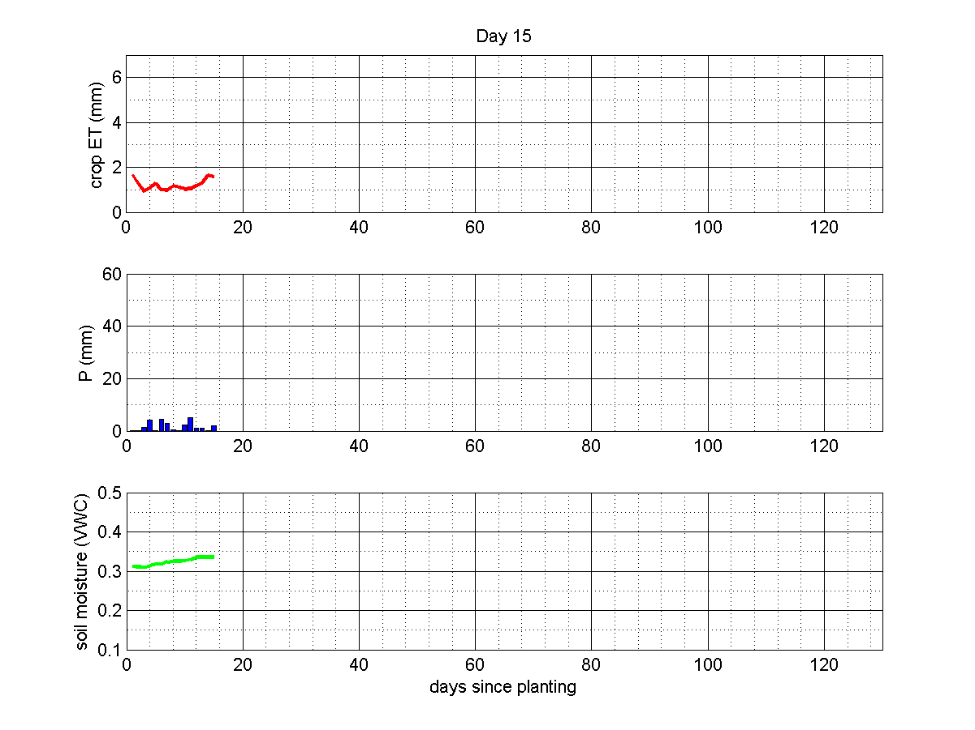
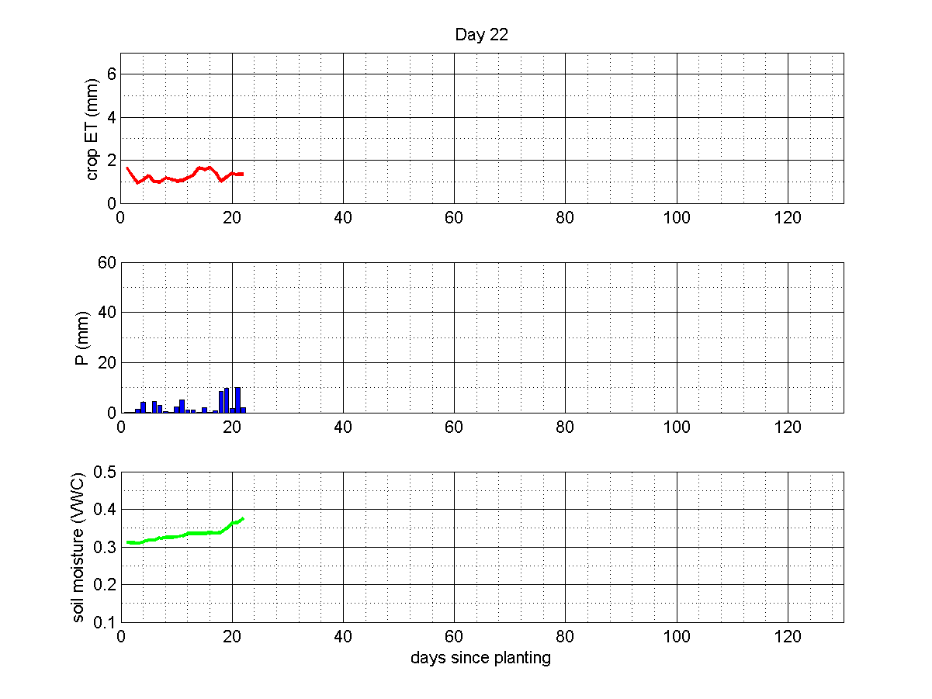
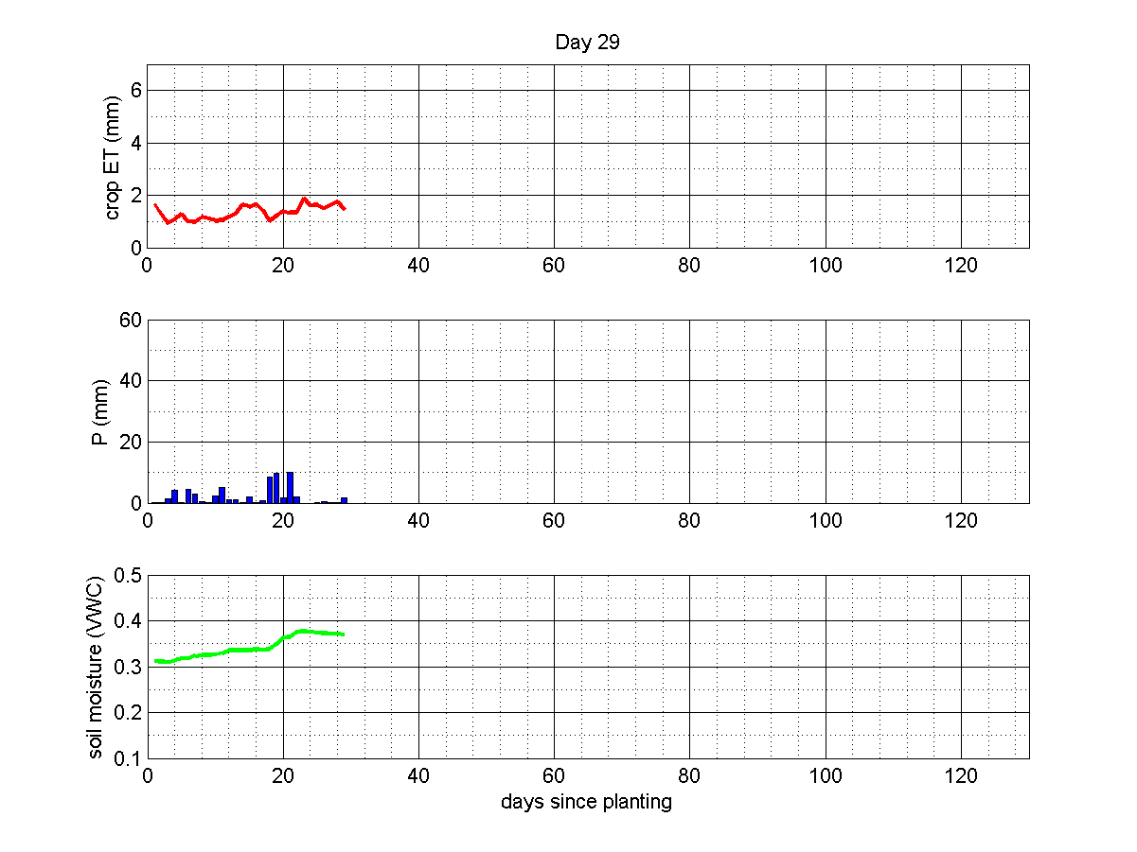
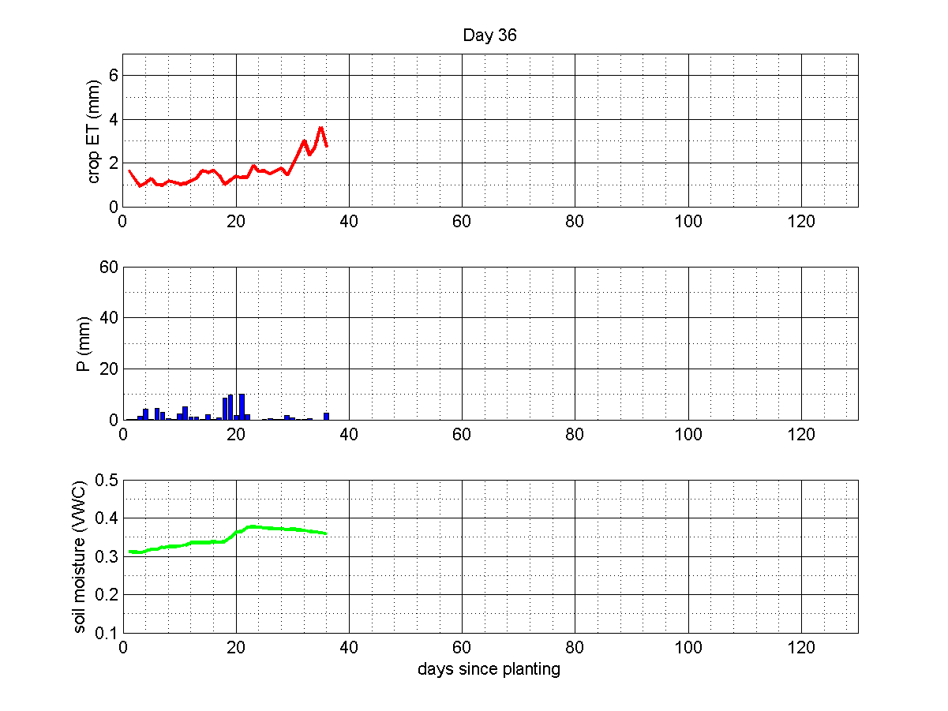
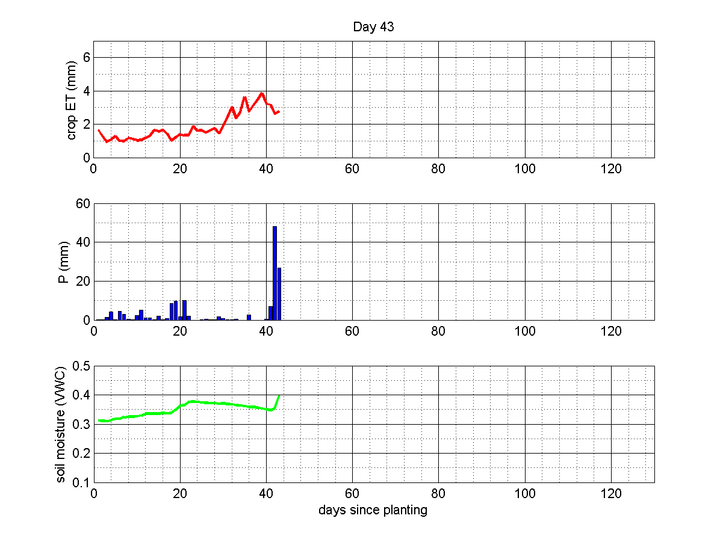
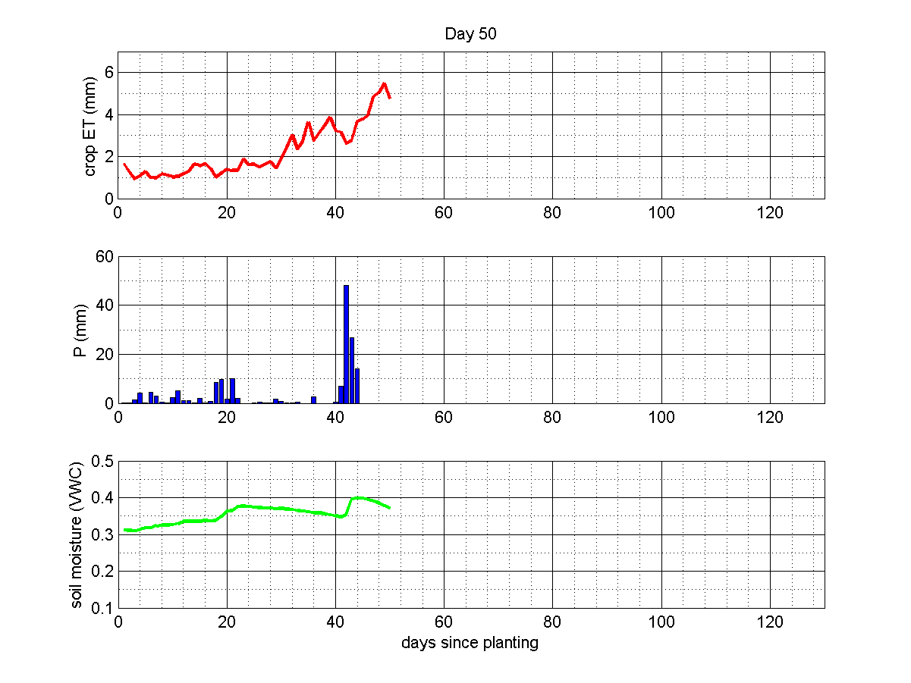
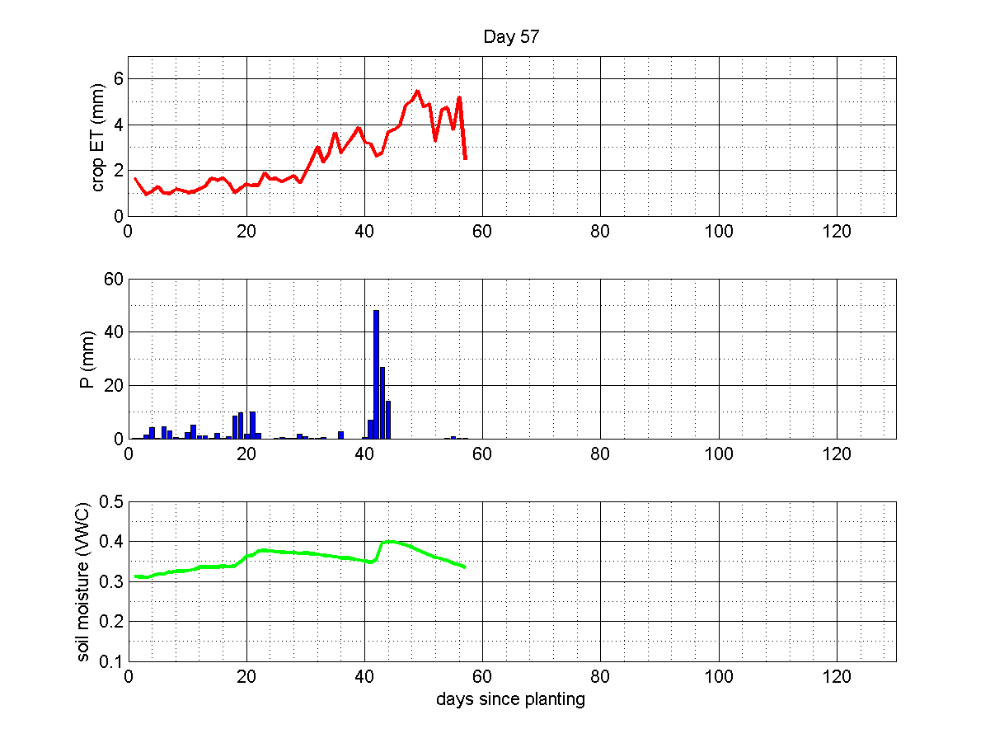
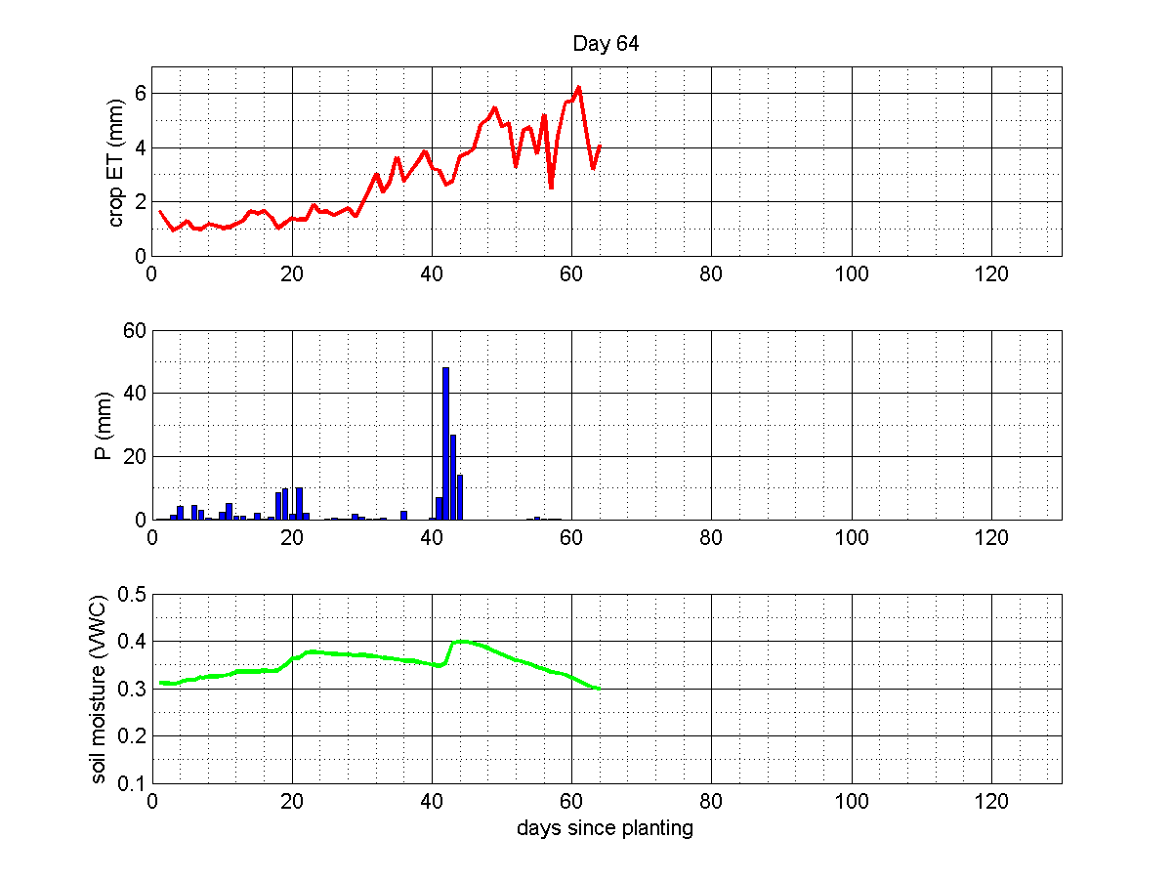
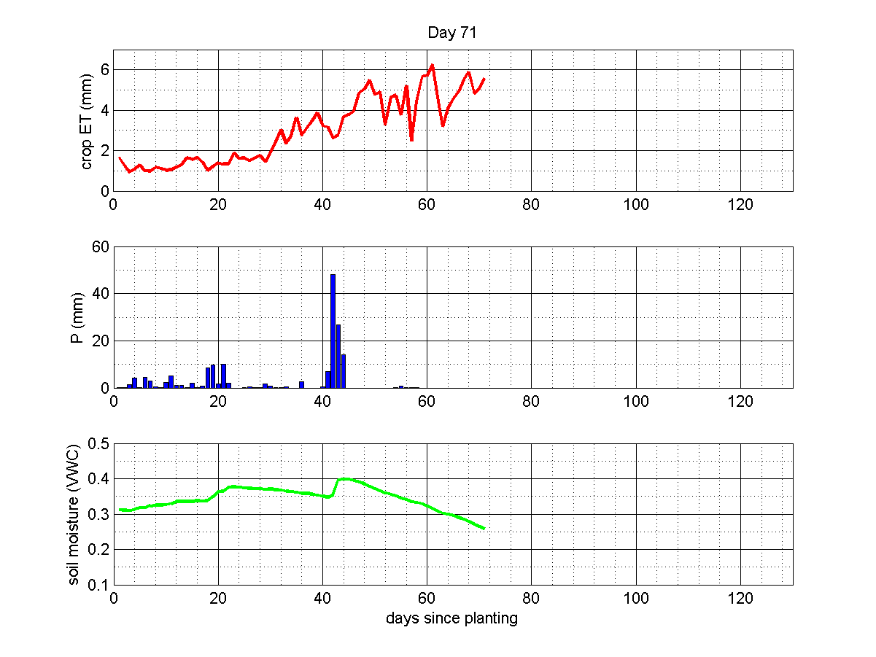
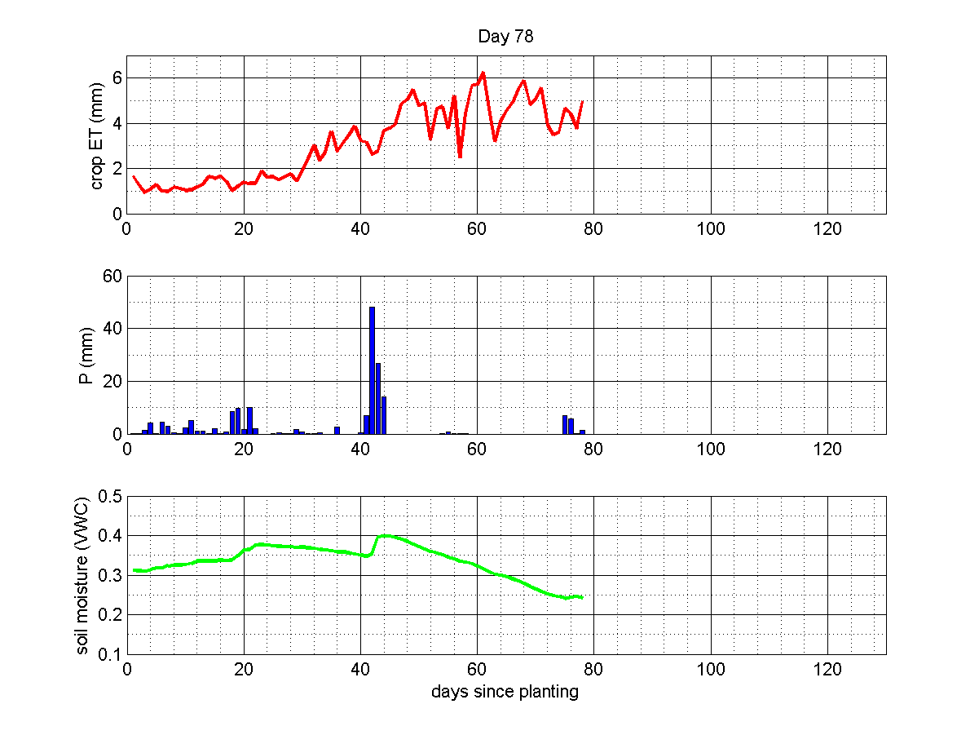
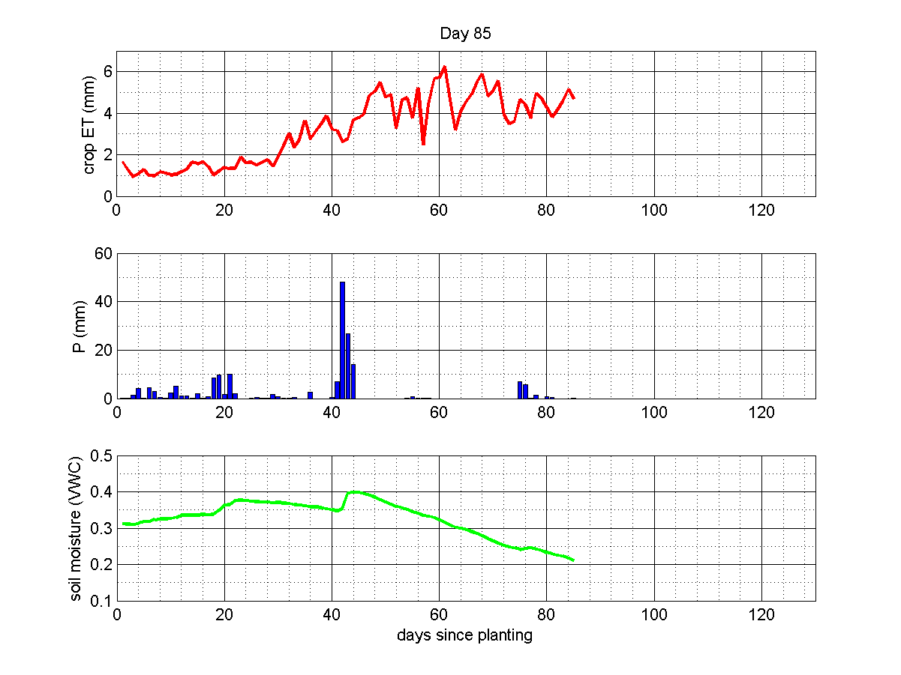
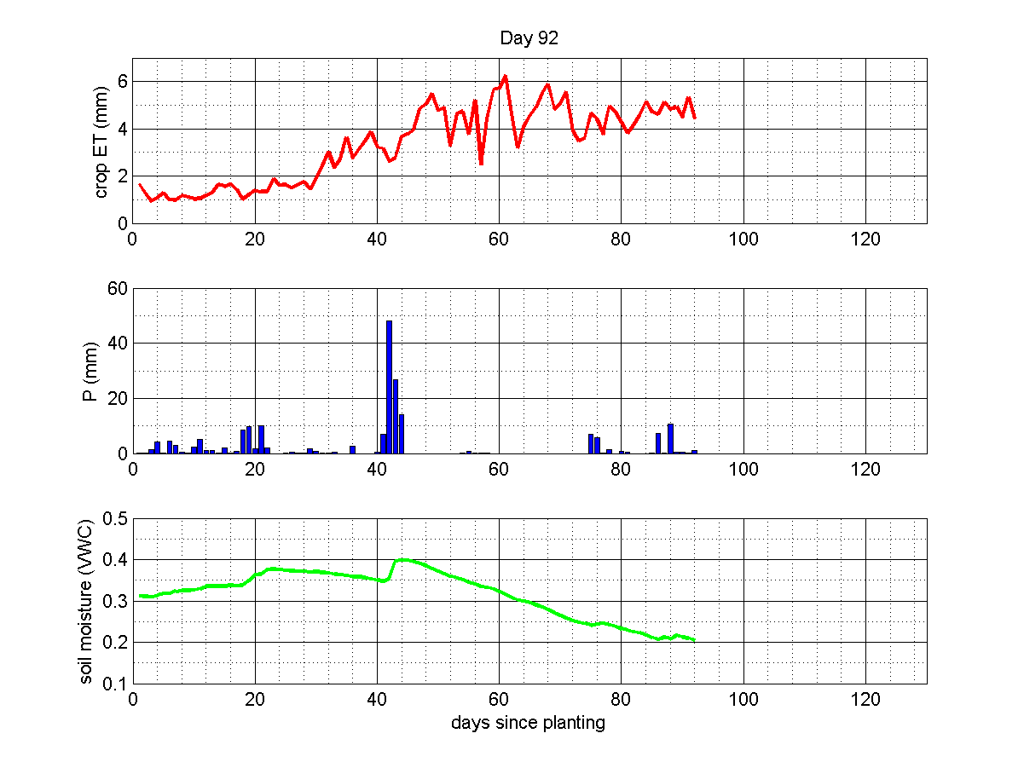
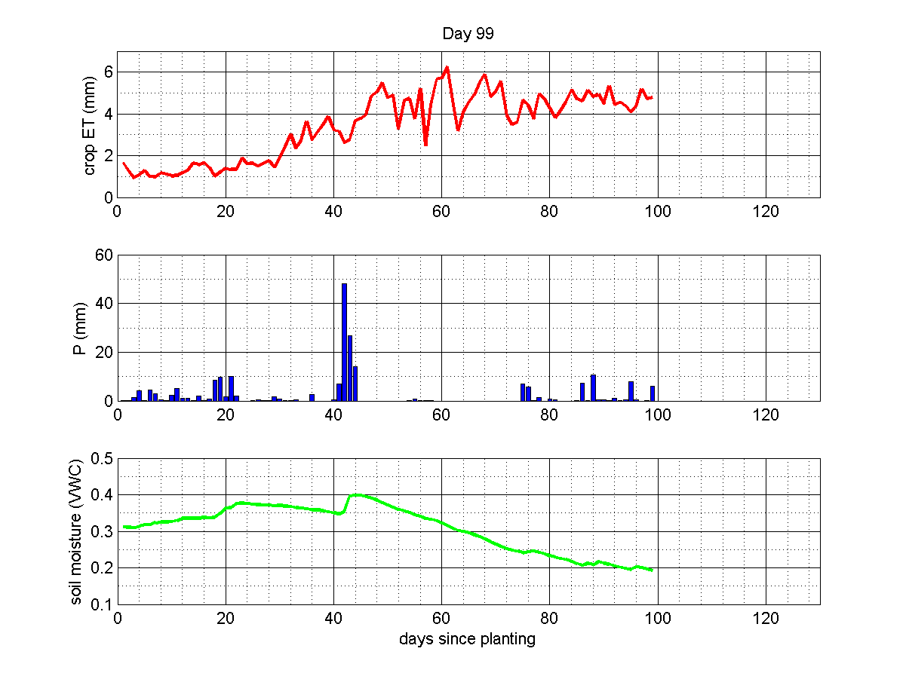
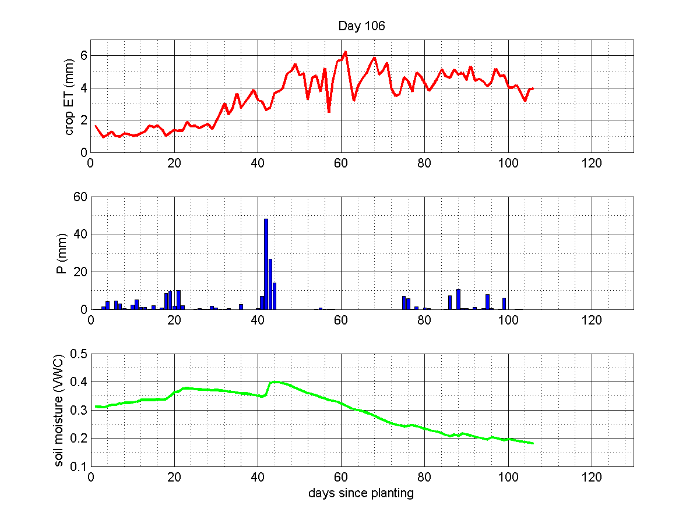
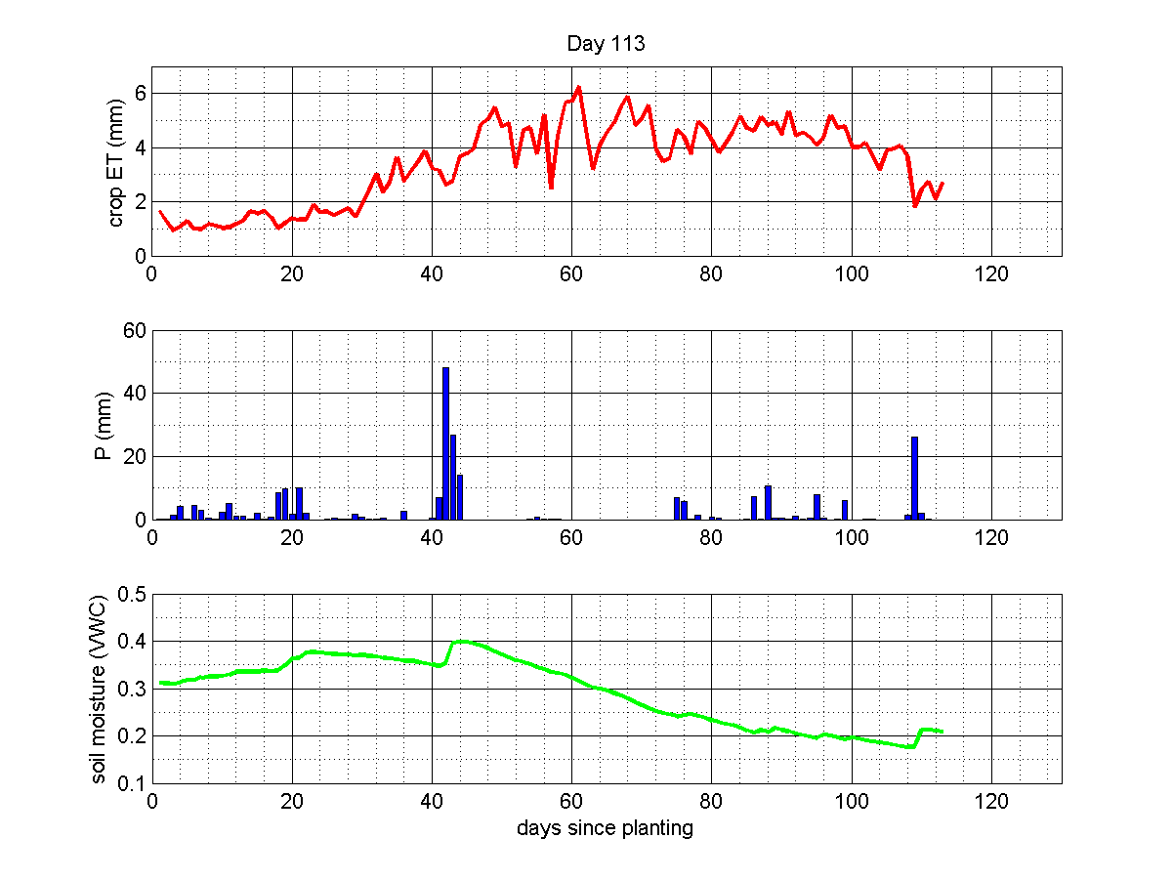
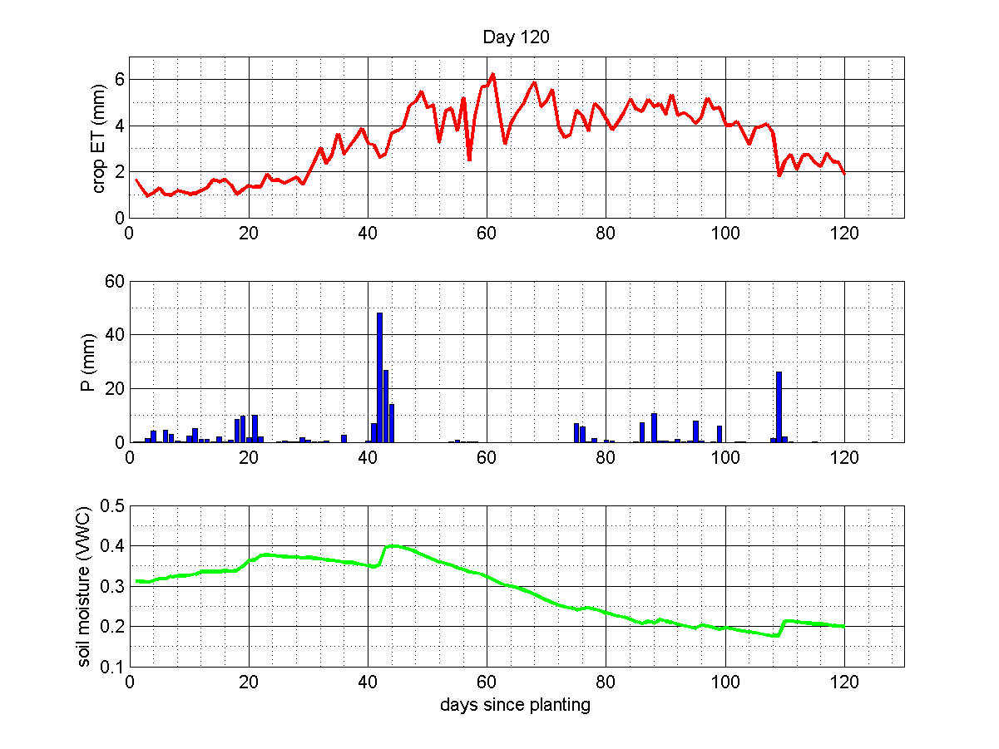
Modelling
Identical with irrigation demand calculator
Uses real-time climate data to calculate current state

Slide 16
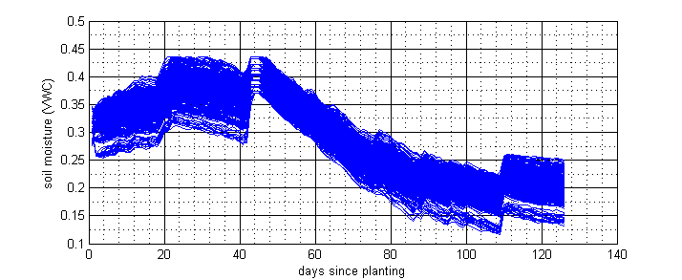
Model uncertainty
Climate input uncertainty
Crop parameter uncertainty
Soil parameter uncertainty

Slide 17
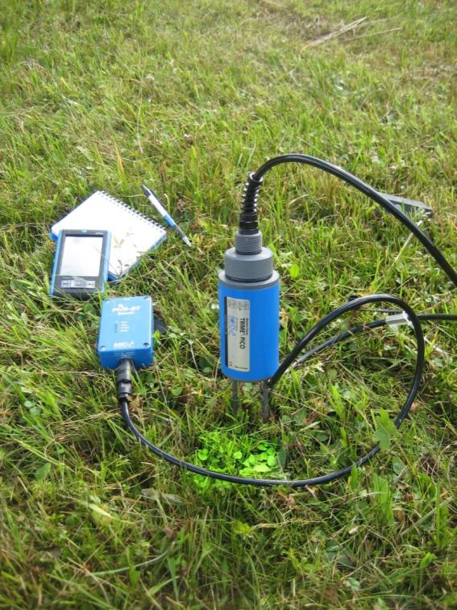
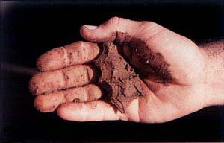
Hard vs Soft Data
HARD DATA
quantitative
precise measurements
expensive
maintenance / power supply
SOFT DATA
qualitative
tacit knowledge
Cheap
no maintenance (=easy)
needs interpretation
(Photo: Kolleger)
(www.nrcs.usda.gov)

Slide 18
Boots and trousers approach
Developed by Hydrology and Climate unit at University Zurich, Switzerland
Expansion to drier conditions in progress
Class | Qualitative indicator criteria
1 | Trousers of a person sitting on the ground stay dry
2 | Trousers of a person sitting on the ground get moist after some min.
3 | Trousers of a person sitting on the ground get wet after some min.
4 | Trousers of a person sitting on the ground get wet immediately
5 | Squelchy noise can be heard stepping on the ground –no water visible
6 | Water squeezes out of the topsoil when stepping on it with a boot
7 | Water can be seen on the soil surface
(Rinderer et al. 2012)

Slide 19
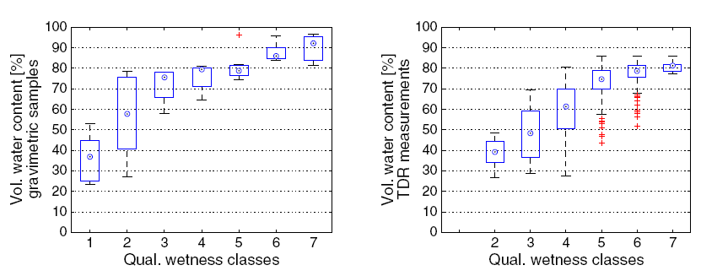
From soft to hard data
Translation into hard data
(Rinderer et al. 2012)

Slide 20
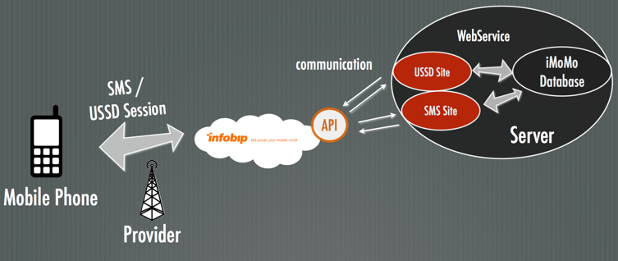
Crowd-Sensing

Slide 21
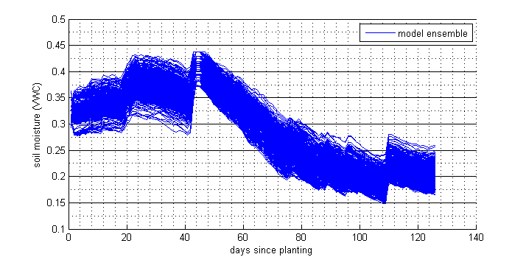
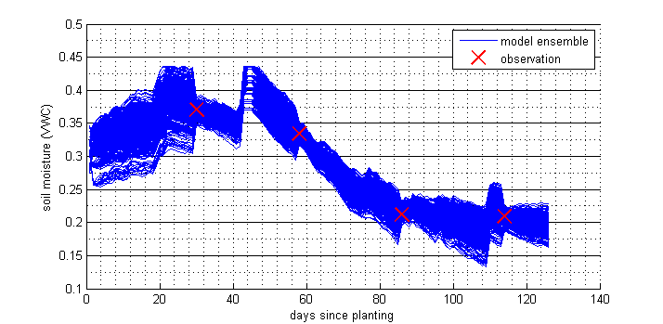
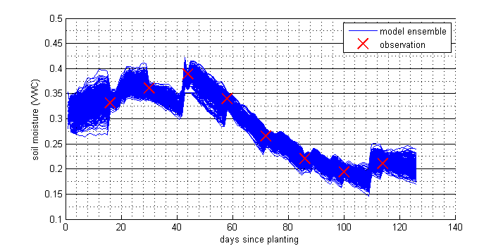
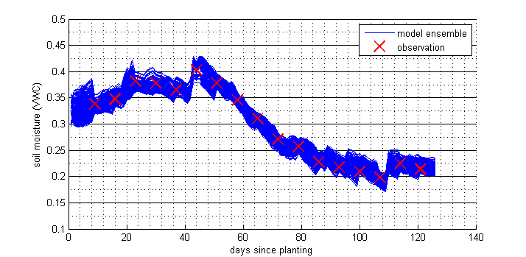
Model update
Using soft sensed data to update model with EnKF:
Accounts for uncertainty of: model and observations

Slide 22
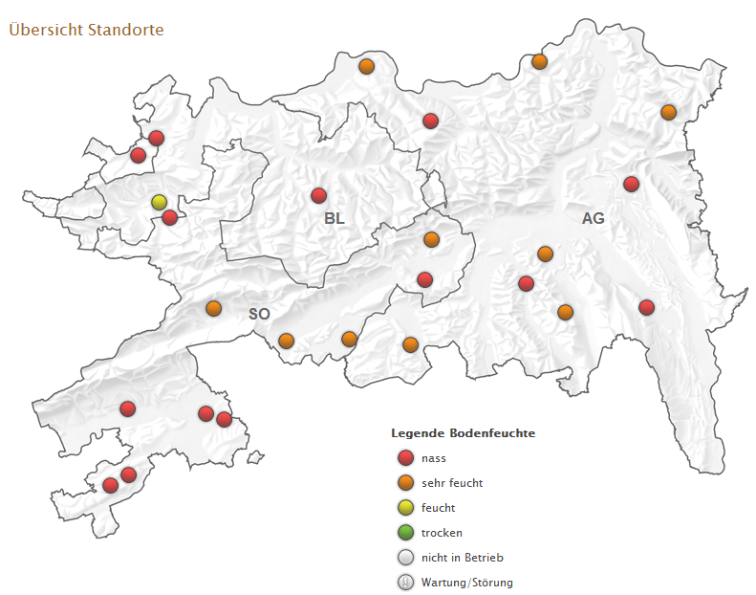
Benefits
spatial real-time information about current soil moisture status / irrigation demand
Very wet
Wet
Moderate
Dry
(www.bodenmessnetz.ch)

Slide 23
Conclusions
Tools to support decision-making of administration, WUAs and farmers
Tools for long-term planning and real-time management
Usage of all available data
Need for local expert knowledge
Vision: web deployment

